Slide 1
NSRIC Inc. (Nature Science Research and Innovation Centre)
Ontario (ON), Canada
Online Education (OE) Division
Essentials of Marketing
Instructor: Kathy Chen
Marketing Program, OE Division
NSRIC Inc.
London, ON, Canada
E-mail: kathyjchen18@gmail.com
https://www.nsric.ca

Slide 2
Week 6: New Product Development
Content covered in this week:
3.2 Chain ratio method, adjustments and estimates
3.3 Idea evaluation, development, and commercialization

Slide 3
Week 6: New Product Development
3.2 Chain ratio method, adjustments and estimates
The chain ratio method: an example
The focus of this lesson is to learn how to apply the chain ratio method, commonly used by marketers at the stage of screening to estimate and forecast the market size for a new product or service. Read the example explained by your instructor and try to solve the problem posed at the end of the lesson.
The following pages illustrate the chain ratio method. In the example discussed, we have a company that wants to bring a new nappy product to the market. The company is in the US; therefore, the numbers have come from the US. The method is the same anytime and anywhere you want to do the chain ratio method. Each audio recording corresponds to the table or text below it.

Slide 4
Week 6: New Product Development
3.2 Chain ratio method, adjustments and estimates
Step 1: How many units will be sold in a year?
Let's start by looking at the number of households. Read the following explaination, which accompanies the table below.
We start by looking at the number of households, and this as per the 2010 census, was 118 million households in the US. Next, we consider the households with children. The number of such households was 30 per cent of the total household. More specifically, households with children below 2.5 years of age was 30 per cent of the households with children.
Why is it 2.5 years? Because industry norms suggest that children below 2.5 years are the ones who really require nappies. How many nappies per day should a household need? A manager may use industry norms, which suggest that the number of nappies needed per day is 4, and of course, there are 365 days in a year.

Slide 5
Week 6: New Product Development
3.2 Chain ratio method, adjustments and estimates
Step 1: How many units will be sold in a year?
Number of households |  | 118,000,000
Households with children (Census) | 30%
Of households with children, % below 2.5 years age | 30%
Number of nappies | 4 per day
Number of days | 365 days
Market size – forecast (first cut)

Slide 6
Week 6: New Product Development
3.2 Chain ratio method, adjustments and estimates
Step 1: How many units will be sold in a year?
Now let's see how the estimates are made. Again, the following explanation accompanies the table underneath.
What we do now is we work through using these numbers to see how the estimates are made. A chain means each of these numbers is multiplied. Therefore, what we will do is multiply them.
We start by multiplying 118 million by 0.3, giving us 35,400,000, which is the number of households with children. As we know, 30 per cent of households have children below 2.5 years. We need to multiply 35,400,000 by 0.3, which gives us 10,620,000. Thus, 10,620,000 is the number of households with children below 2.5 years old. These households use 4 nappies per day, which means that we need to multiply 10,620,000 by 4, giving us 42,480,000 nappies per day.

Slide 7
Week 6: New Product Development
3.2 Chain ratio method, adjustments and estimates
Step 1: How many units will be sold in a year?
To estimate the amount of nappies used per year, we need to multiply 42,480,000 by 365, giving us 15.5 billion. This would be our forecasted market size. That is, the first annual market size forecast. But remember now, this is based on our calculation of every possible household and our
assumption that
everybody will need
4 nappies a day.
These are extremely
strong assumptions,
and most managers
need to make some
corrections based on
their knowledge and
such like from the
market.
Number of households |  | 118,000,000
Households with children (Census) | 30% | 35,400,000
Of households with children, % below 2.5 years age | 30% | 10,620,000
Number of nappies | 4 per day | 42,480,000
Number of days | 365 days | 15,505,200,000
Market size – forecast (first cut) |  | 15.5 billion

Slide 8
Week 6: New Product Development
3.2 Chain ratio method, adjustments and estimates
Step 2: Run an ‘intention to buy’ survey for generating inputs to chain ratio
We notice that if we were to run an 'intention to buy' survey for generating inputs to the chain ratio, and ask people 'would you definitely buy', 'probably buy', 'may or may not buy', et cetera, we can figure out that some people who say they will buy, won't buy, and some people who say they won't buy, will actually buy.
Please note that the intent-to-buy scale used for generating some inputs to chain ratio is as follows: 'definitely would buy'; 'probably would buy'; 'may or may not buy'; 'probably would not buy'; 'definitely would not buy.'
Then, from there, we scale it down with a survey because remember, making a new product is expensive. So, it's better to have a good idea of the return on investment before we make that investment. Adjusting the stated intention to get actual purchase is important. As mentioned by Frank M. Bass in his famous 1969 paper, adjusting stated intention is essential.

Slide 9
Week 6: New Product Development
3.2 Chain ratio method, adjustments and estimates
Step 2: Run an ‘intention to buy’ survey for generating inputs to chain ratio
Intent-to-buy-scale
Definitely would buy
Probably would buy
May or may not buy
Probably would not buy
Definitely would not buy
Scale it down with a survey
Adjust the stated intention
Jamieson, L.F. and Bass, F.M. (1989). Adjusting Stated Intention Measures to Predict Trial Purchase of New Products: A Comparison of Models and Methods. Journal of Marketing Research, 26(3), pp. 336–345.

Slide 10
Week 6: New Product Development
3.2 Chain ratio method, adjustments and estimates
Step 3: Make corrections
Now let's look at the corrections for inputs 1 and 2.
We will start with our old forecast, which is 15.5 billion, and there are 4 corrections or inputs to be taken into account. The first one is an intention to purchase survey. And based on our survey results, we find that only 50 per cent of that original 15.5 billion market is actually going to purchase. So we multiply 15.5 billion by 0.5, giving us 7,752,600,000. This is the updated market size based on the survey results.
The second input is essentially the manager's judgement. The manager knows, either from industrial experience or through marketing research, that even this number will get lowered to about 40 per cent. So this managerial judgement, usually based on industry norms, indicates that only 40 per cent of the previous number will actually be our market. Thus, we multiply 7,752,600,000 by 0.4, giving us 3,101,040,000. This is the updated market size after managerial judgement.

Slide 11
Week 6: New Product Development
3.2 Chain ratio method, adjustments and estimates
Step 3: Make corrections
Now let's look at the corrections for inputs 1 and 2.
Number of households |  | 118,000,000
Households with children (Census) | 30% | 35,400,000
Of households with children, % below 2.5 years age | 30% | 10,620,000
Number of nappies | 4 per day | 42,480,000
Number of days | 365 days | 15,505,200,000
Market size - forecast (first cut) |  | 15.5 billion

Slide 12
Week 6: New Product Development
3.2 Chain ratio method, adjustments and estimates
Step 3: Make corrections
Now let's look at the corrections for inputs 1 and 2.
Input 1: Intention to purchase (survey) | 50% | 7,752,600,000
Input 2: Discount/correction factor | 40% | 3,101,040,000
Input 3: Availability (distribution; mgmt. judgement) | 40%
Input 4: Aware, given available (ads; mgmt. judgement) | 50%
Market size – forecast (new)

Slide 13
Week 6: New Product Development
3.2 Chain ratio method, adjustments and estimates
Step 3: Make corrections
Finally, we'll look at the corrections for inputs 3 and 4
The third one is availability. Now imagine that you have decided not to put these nappies up for sale in certain parts of the country. This may be because the retailer cannot give you enough space, or maybe it's not worthwhile for you to buy shelf space at that point. Or, imagine that the manager decides that only 40 per cent of the total available sales or distribution will be targeted. Your product cannot be available to all the customers that you think you can reach. At this point, we need to further scale down the previous number by 40 per cent.
Therefore, we multiply 3,101,040,000 by 0.4, giving us 1,240,416,000. This is the updated market size after availability analysis.

Slide 14
Week 6: New Product Development
3.2 Chain ratio method, adjustments and estimates
Step 3: Make corrections
Finally, we'll look at the corrections for inputs 3 and 4
Finally, how will you get a customer to pick up the new product? There has to be advertising, promotions, etc, to inform the customer about the existence of the new product. The manager has decided that we can only target 50 per cent of the people whom we'd like to target. That's the budget restriction, and that's half the number we think will actually be informed and become aware of the product. So, we multiply 1,240,416,000 by 0.5, giving us 620,208,000. This is the estimated market size after marketing budget allocation, and that is indeed close enough to the real market of a new nappy in terms of annual market potential.
Thus, although our first stage calculations had suggested a market potential of 15.5 billion, after adjustments we arrive at a much smaller number, approximately 620 million.

Slide 15
Week 6: New Product Development
3.2 Chain ratio method, adjustments and estimates
Step 3: Make corrections
Finally, we'll look at the corrections for inputs 3 and 4
Number of households |  | 118,000,000
Households with children (Census) | 30% | 35,400,000
Of households with children, % below 2.5 years age | 30% | 10,620,000
Number of nappies | 4 per day | 42,480,000
Number of days | 365 days | 15,505,200,000
Market size – forecast (first cut) |  | 15.5 billion

Slide 16
Week 6: New Product Development
3.2 Chain ratio method, adjustments and estimates
Step 3: Make corrections
Finally, we'll look at the corrections for inputs 3 and 4
Input 1: Intention to purchase (survey) | 50% | 7,752,600,000
Input 2: Discount/correction factor | 40% | 3,101,040,000
Input 3: Availability (distribution; mgmt. judgement) | 40% | 1,240,416,000
Input 4: Aware, given available (ads; mgmt. judgement) | 50% | 620,208,000
Market size – forecast (new) |  | 620 million

Slide 17
Week 6: New Product Development
3.2 Chain ratio method, adjustments and estimates
Activity: Chain ratio method problem
In this exercise, you will be estimating the annual market potential of an online grocery chain. Our assumptions for this exercise are:
Households with children are likely to buy their groceries online.
Households that currently go to supermarkets and grocery stores will now go online.
Households need internet access to go online.
These are the only three assumptions we have made. The numbers have been provided to you below. Please work through the process outlined on the previous page and come up with the market potential for this new online grocery chain.
A box has been provided for you to work through your answer, but please be aware that your answer will not be saved. This exercise is not graded and is simply an opportunity for you to practice working out the market forecast. Once you have had a go, you can reveal the model answer underneath.

Slide 18
Week 6: New Product Development
Estimated online grocery sales
Number of households (2010 Census) | 118 million
Grocery purchases per household per year (52x100) | $5200
Percentage of sales from supermarkets and grocery stores | 84%
Percentage of households with children (Census) | 30%
Percentage of households with internet access (Census Bureau) | 67%
Will order groceries online if available (survey) | 25%
Discount of survey intentions | 50%
Online grocery shopping availability (guess) | 40%
Awareness given availability (guess) | 50%
Market forecast | $???
Question
What is the market forecast for
the online grocery chain?
Reflect on this question, then
view the answer below.
Market forecast: $2.5 billion

Slide 19
Week 6: New Product Development
3.3 Idea evaluation, development and commercialization
1. Idea evaluation: conjoint analysis
This lesson uses examples to explain the purpose, benefits and challenges of the following methods: conjoint analysis (used during the stage of idea evaluation), simulated test marketing (in the stage of development) and finally, test marketing (in the stage of commercialization).
What is a conjoint analysis?
Consumers tend to think they know what they want, but when you ask them and design a product or service based on that data, it turns out that it isn’t quite what they wanted.
What people think they want versus what they actually want can differ, and this is not because they are lying.
Once we have unpacked the attributes of a product and run what is called a conjoint analysis, we can work out what attributes or aspects of the product are really important by looking at their preferences and choices.

Slide 20
Week 6: New Product Development
3.3 Idea evaluation, development and commercialization
Example: Stanford MBAs’ direct ratings of attribute importance in job choice
Here is a real-life example: Stanford MBAs rated the importance of what mattered to them when they looked for jobs after graduating.
They ran two surveys with students: the first survey asked what was important for them in a job. The second survey asked people to rate the combination of attributes when looking for a job.
The results for the first survey showed that the most important attribute was people/culture, followed by the region of the US where they would work, and then, functional area. Salary was sixth (see column ‘What MBA’s said’ in the table below).
After running a conjoint analysis, we see that, in fact, salary is the most important attribute, while the region of the US remains at number two and the job location comes third. People/culture is only fourth in terms of importance (see the column ‘Rank based on conjoint’ in the table).

Slide 21
Week 6: New Product Development
3.3 Idea evaluation, development and commercialization
Job attribute | What MBAs said... | Rank based on conjoint
Salary | 6th | 1st
Region of US | 2nd | 2nd
Job location | 5th | 3rd
People/culture | 1st | 4th
Functional area | 3rd | 5th
Firm growth | 7th | 6th
Business travel | 8th | 7th
Opportunity to advance | 4th | 8th
Thus, while the MBA graduates thought that the people and culture of the company they were going to work for would matter most, in reality, this was much less important. When we studied the topic of customer decision-making, we analysed a product or service as a group of attributes. Similarly, a conjoint analysis assumes that all products or services are a combination of attributes.

Slide 22
Week 6: New Product Development
3.3 Idea evaluation, development and commercialization
2. How do we do a conjoint analysis?
What we do is look at all the attributes of the new product and design different combinations. For example, suppose we are designing a new pizza:
We could consider the following attributes: crust
(crispy, thin, thick or stuffed), sauce (tomato-based
or cheese-based), number of toppings and price.
Now we can proceed to designing different combinations of attributes, and different profiles according to each. For example, we could have:
a thin crust pizza, with tomato sauce, three toppings and a price of $10
a thick crust pizza, with tomato sauce, five toppings and a price of $15

Slide 23
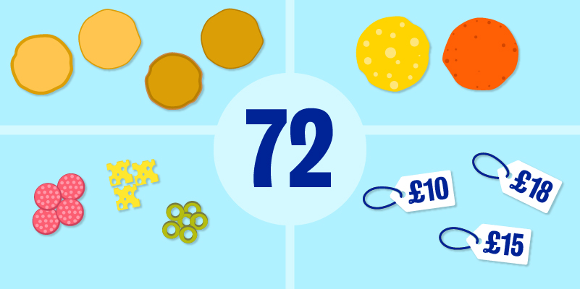
Week 6: New Product Development
3.3 Idea evaluation, development and commercialization
2. How do we do a conjoint analysis?
With four crust-types, two sauce-types, three
topping-types (it could be any number of toppings:
three, five, six toppings, etc) and three different
prices ($10, $15 and $18), we would get 72
possible combinations or profiles for a new pizza.
We would use a panel of customers, who would
see some combinations of these profiles (nobody
would look at all 72 profiles), perhaps about 10
profiles. Each panel member would be asked to
rate each profile on a scale of 1-100. The more
attractive the profile, the higher the rating.

Slide 24
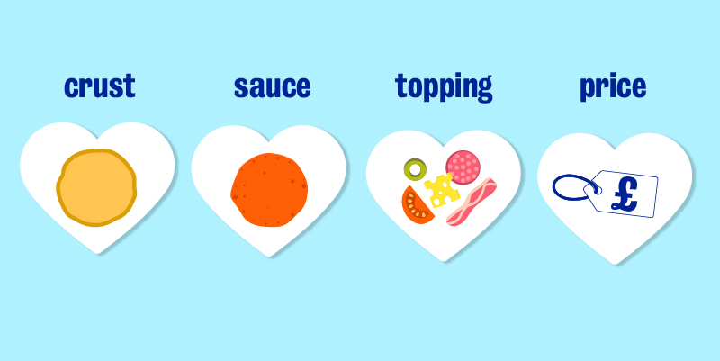
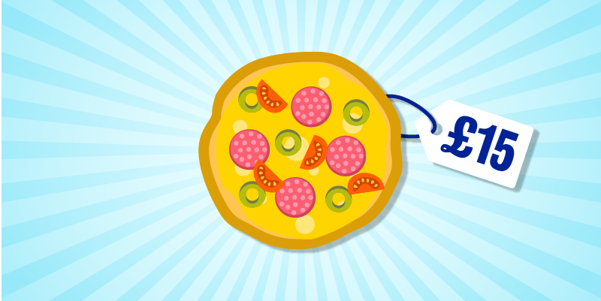
Week 6: New Product Development
2. How do we do a conjoint analysis?
Using these data, we can run a regression analysis
and figure out what is really important
to the customer: crust, sauce, number of toppings or
price. This is how we perform a conjoint analysis.
Through it, we can work out which is the most important attribute, the second most important, etc.
Once we know the importance of each attribute, we
can design what would be considered an ideal pizza
for this target group of people. We have then
concluded the idea evaluation stage for our new product.
Without having developed any product, we can ask our customers to give us feedback on what they would choose given the product attributes. These can then be put into a conjoint analysis. For marketing managers, conjoint analysis can be incredibly interesting and useful, as it allows them to evaluate an idea for a new product without actually making any investment in manufacturing it.

Slide 25
Week 6: New Product Development
3.3 Idea evaluation, development and commercialization
3. Development: simulated test marketing (STM)
At the development stage, the product and part of the marketing mix are tested, using a process known as simulated test marketing (STM) or laboratory test marketing.
An STM simulates an actual test market to estimate:
initial purchase rates
ultimate repeat purchase rates
without building the product prototype.

Slide 26
Week 6: New Product Development
3.3 Idea evaluation, development and commercialization
Benefits of STMs
Compared to true test markets, conducting an STM presents the following advantages:
It allows for obtaining a quick turnaround. You can gain a good impression of the target consumers’ response to the product, especially if it is a product that costs a lot to start manufacturing and selling.
STMs are fast (they can be completed in approximately three months), relatively cheap ($250,000 on average), flexible and very accurate. By 'flexible' we mean that the firm bringing the product to market has a lot of manoeuvrability in terms of changing the marketing mix. This is because the laboratory-like settings of STMs provide the firm with a lot of control over the process.
For example, if a particular ad isn’t working, we can try another one to see if that will change brand or product awareness, and we can see if there is first-round initial purchase or not. This has been found to be very accurate.

Slide 27
Week 6: New Product Development
Limitations of STMs
What are some of the limitations of doing simulated test marketing?
It relies on assumption, ie it assumes that preference data and purchase/repurchase decisions are valid predictors of what would actually happen in the marketplace. In other words, it assumes that what we see in the simulation or in the laboratories is actually going to be reflected in the real world when we launch.
Most of the people who participate in STMs are convenience samples, and convenience samples usually are not representative of the population. It might be that our real population is not at all like the convenience sample, and thus we will get very accurate but not appropriate results. As a consequence, we might actually end up making more of a product that doesn’t sell, or we might be out of stock. This will be unpopular with customers because we cannot provide the product which is needed.
The third issue is that, because it is like a laboratory, a lot of people commit to showing up but don’t show. Hence our sample might be tricky to manage.
Despite these limitations, STMs or laboratory test markets are one of the biggest success stories in market research.

Slide 28
Week 6: New Product Development
3.3 Idea evaluation, development and commercialization
4. Example: typical STM procedure
How is STM usually undertaken?
STM is mostly performed by a marketing research firm on behalf of the company, or, if the company is a really large firm, it will have its own marketing research arm do it.
Step 1: recruitment
First, we recruit qualified shoppers. These are people who resemble our target segment as closely as possible. We brief them and ask them questions about their preferences and usage.
Step 2: background questions
We then ask them some background questions. For instance, let’s use the nappies example: how many do they use, what kind of brands are they using currently, what attributes do they really care about, etc.

Slide 29
Week 6: New Product Development
3.3 Idea evaluation, development and commercialization
4. Example: typical STM procedure
Step 3: screening of ads
Next, some of the qualified shoppers are exposed to some advertising, and some are not. The second group essentially act as the control group.
Step 4: simulated shopping
After seeing the advertising, everybody (including the control group) is given mock or real money (it has become extremely easy with online purchases to run this laboratory testing) and invited to the store to buy any nappy product.
Step 5: debriefing
At step five, we can actually work out if the shoppers bought our new product or another. Remember, some people who said they might buy will not buy, and some people who said they wouldn’t buy will end up buying. So, why not give them a free sample to take home and try, or even post one to them if the store is online.

Slide 30
Week 6: New Product Development
3.3 Idea evaluation, development and commercialization
4. Example: typical STM procedure
Step 6: reinterviewing
A few weeks after they have tried the product, the shoppers are contacted. Satisfaction usage, and any other thoughts on the new product, is gathered from them. We also ask them if they would repurchase it, and we even make it available to them online through ‘click and buy’.
Step 7: consider control groups
We repeat the same process with the people who had not seen the ads. Whether one sees the ad or not, they are all given that pot of money and allowed to go online and buy the product.

Slide 31
Week 6: New Product Development
3.3 Idea evaluation, development and commercialization
4. Example: typical STM procedure
From here we can get very valuable information, for example:
Did they like our product or not?
Would they repurchase it or not?
Was the advertisement good at informing them about our new product?
The STM gives us an idea of whether launching a new product would be worthwhile. Also, if people like the ad, they will talk about it, and this promotes the product further through word-of-mouth.
In today’s world, we can monitor a lot of things by conducting an STM. It has become a very interesting approach to thinking about new product developments.

Slide 32
Week 6: New Product Development
3.3 Idea evaluation, development and commercialization
5. Commercialization: test marketing
The last step of the new product development process is commercialization, and under that, we will talk about test marketing.
Test marketing means launching a new product in limited but carefully selected parts of the market. This is the real market, the real retailer, real advertising, et cetera, so the goal is:
● to gain information and experience through a marketing program before making a full or total commitment to the new product, and
● to predict the program’s outcome when it is applied to the total market.
There are two types of test markets:
● the full-blown or sell-in test market, and
● the controlled test market.

Slide 33
Week 6: New Product Development
3.3 Idea evaluation, development and commercialization
5. Commercialization: test marketing
Sell-in test market
This type is where all of the people in certain cities will see an ad and will have access to the product through various retailers. The cities are selected based on their representativeness to the population of interest and must find retail space. Everybody is targeted.
So, let’s assume we want to do the test in the UK. We might choose Birmingham, Manchester and Liverpool. All the people in those cities will find the product available in their stores or online for shipping to them, and they will see ads that are targeted to them: TV, and more recently, targeted mobile advertising, seem to be effective ways to reach the people in such cities. This is called the sell-in test market or full-blown test market.

Slide 34
Week 6: New Product Development
3.3 Idea evaluation, development and commercialization
5. Commercialization: test marketing
The challenges we face here include making decisions on the following questions:
How do we select these test cities?
How do we monitor the test marketing? Remember, it is only in these cities that the ad will be seen, and other people, their friends and family in other cities, will not see the ad or the product.
When exactly do we want to do the test marketing (timing)?
How do we manage the evaluation?
How do we manage the purchase and repurchase rates?
What are the costs of doing the test marketing in certain cities?

Slide 35
Week 6: New Product Development
3.3 Idea evaluation, development and commercialization
5. Commercialization: test marketing
Controlled test market
Unlike the sell-in test market, here, only some people in a particular city will see the ad and find the product available to buy.
So, while the city is pre-arranged, purchases of a panel (a panel is a certain number of pre-selected consumers) are monitored through scanner data. For example:
The people who are part of the panel will have televised (or electronic) advertising specifically broadcasted to them.
Their behaviour will also be monitored in store/online.
They will have an ID card that they will present at the store and which will track them. Some of these things will be done by IRI behaviours.
There are about 3000 households in seven US cities that have an ID against which they are monitored. Their TV and their mobiles are tracked. In the UK, Nielsen and Kantar run such panels.

Slide 36
Week 6: New Product Development
3.3 Idea evaluation, development and commercialization
5. Commercialization: test marketing
New product decisions
To summarize, some of the questions that are associated with new product development are:
Will the product work?
Is it an attractive concept? For this we use concept testing. For market potential, we use the chain ratio method to work out whether the product will give us enough return on investments, or we use conjoint analysis to figure out specific features for the new product.
How (and when) will it get there?
How and when will the new product reach a sales volume where it breaks even? We can work this out with simulated test marketing, regular test marketing and various predictive models like the Bass diffusion model, which predicts how quickly the product will catch up with the market.

